Slide 1
3. Exploratory Data Analysis
Haiyan Cheng
Willamette University
CS-429
Spring 2018

Slide 2
Statistical Inference
Our life is a data-generating process
It contains randomness and uncertainty
Statistical inference—the overall process of going from the world to the data, and then from the data back to the world.
Developing of procedures, methods and theorems that allow us to extract meaning and information from data that has been generated by stochastic (random) processes.

Slide 3
Key terms in statistical inference
Population—any set of object
Observations—characteristics of population (N)
Sample—subset of observations (n)
Use samples to draw conclusions and make inference about the population
May introduce “Bias”
Be careful with the underlying “assumption” when you draw samples

Slide 4
Increased challenges in statistical inference
Various data format:
Traditional: Numerical, categorical, binary
Text: emails, tweets, newspaper articles
Records: user-level data, timestamped event data, json-formatted log files
Geo-based location data
Network
Sensor data
Images
How to sample?
New methods?

Slide 5
Big Data
“Big” is a moving target-only relative, when the size of the data outstrips the state-of-the-art computational solutions
“Big” is when you can’t fit it on one machine
“Big data” is a cultural phenomenon
The 4 Vs: Volume, variety ,velocity, value

Slide 6
Statistical Modeling
A model is our attempt to understand and represent the nature of reality through a particular lens, it’s constructed artificially
Modeling involves both art and science.
Need to make assumptions about the underlying structure of the reality
Where to start? → EDA

Slide 7
EDA
An approach for data analysis that employs a variety of techniques to
Maximize insight into a data set
Uncovering underlying structure
Extract important variables
Detect outliers and anomalies
Test underlying assumptions
Develop models
Promoted by John Turkey to encourage statisticians t explore the data

Slide 8
CDA vs EDA vs IDA
CDA: confirmatory data analysis concerns itself with modeling and hypothesis
IDA: Initial data analysis (checking assumption, handle missing value, transform variables)
EDA: (Exploratory Data Analysis) no hypothesis, no model, EDA encompasses IDA

Slide 9
Classical Data Analysis vs EDA
Classical:
Problem → Data➔ Model→Analysis→Conclusions
EDA:
Problem→Data→Analysis→Model→conclusions

Slide 10
Basic tools
Plot
Graphs
Summary Statistics

Slide 11
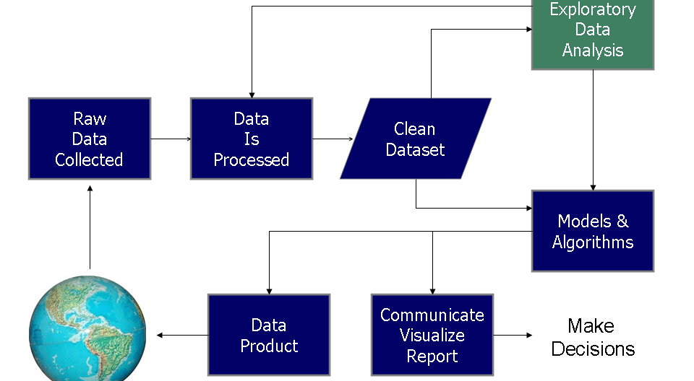
Data Science process

Slide 12
Plot and graphs
Plot distributions of all variables
Plot time series data
Transform variables
Look for pairwise relationships between variables using scatter plots.

Slide 13
Summary Statistics
Mean, mode, median
Minimum, maximum
Standard deviation
Quantiles
Outliers

Slide 14
EDA is a mindset
Understand the data-gain intuition, understand the shape, connect understanding of the process that generated the data to the data itself

Slide 15
Probability Distribution
Building block for statistical modeling
Named probability distributions
Assigning a probability to a subset of possible outcomes, and have corresponding functions.
Commonly used Probability distribution (described by PDF, P.31)
Univariate distribution p(x), joint distribution p(x, y), conditional distribution p(x|y)

Slide 16
Normal Distribution
Bell curve
Parameters
U: mean (location)
O^2: variance squared

Slide 17
Probability Density Function
PDF
y = f(x)
u = mean
O = standard deviation
O^2 = variance

Slide 18
Fitting a model
Estimate the parameters of the model using the observed data.
Usually involves an optimization algorithm (MLE)
Read in data → specify functional form→R use built-in optimization methods to give you most likely values of the parameters given the data
Overfitting– model is not good enough to capture reality beyond the sampled data

Slide 19
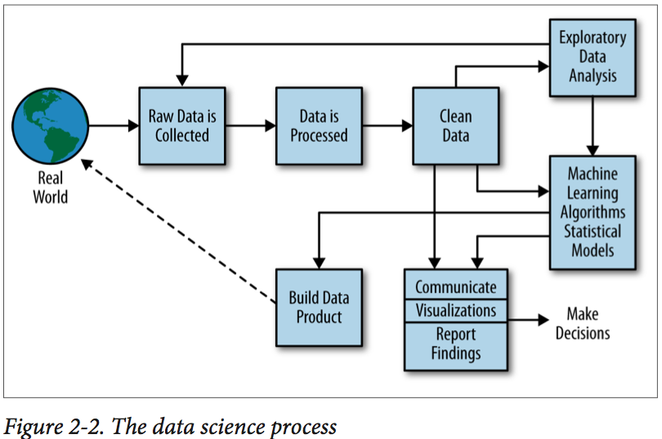
Data Science process

Slide 20
Scientific Methods
Ask a question
Do background research
Construct a hypothesis
Test hypothesis by doing an experiment
Analyze data and draw conclusion
Communicate results

Slide 21
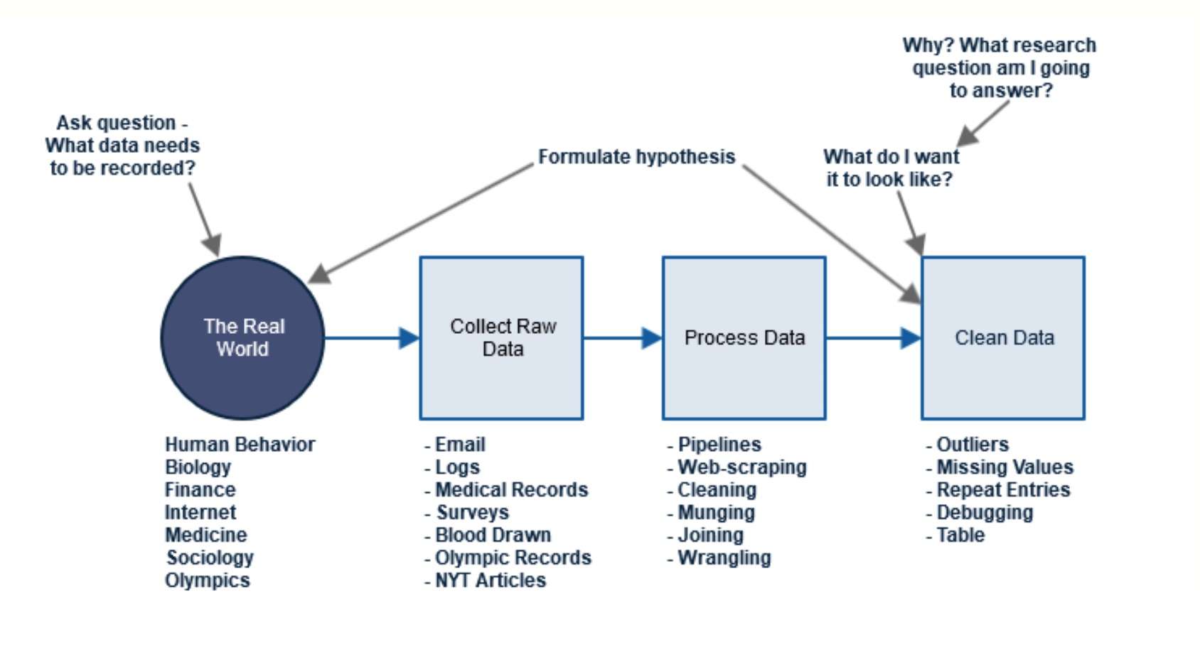
The role of a Data Scientist

